Slide 1
Hepatobiliary manifestations of IBD
ECCO Guidelines on Extraintestinal Manifestations in Inflammatory Bowel Disease

Slide 2
A heterogenous group of hepatobiliary conditions can occur in IBD, ranging from a transient liver test abnormality [LTA] to life-threatening liver failure.
LTAs may already be present at IBD diagnosis or develop later.
LTAs may be silent or appear in combination with nonspecific symptoms, such as fatigue, nausea, and anorexia.

Slide 3
Adult patients with IBD have an estimated risk of 5% of developing an immune-related liver disease, including PSC, autoimmune hepatitis [AIH], or both, with incidence more common in children.
Nonalcoholic fatty liver disease [NAFLD] is also a very common cause of disturbed liver function in IBD.
A meta-analysis revealed that one third of all IBD patients have NAFLD, a prevalence 2-fold greater than that of healthy controls .
In addition, most drugs used to treat IBD have the potential to cause liver injury.

Slide 4
A basic panel of liver tests, which includes alanine aminotransferase, alkaline phosphatase, g-glutamyltransferase, and total serum bilirubin should be performed on the treatment-naive patient with suspected IBD and then repeated periodically throughout follow up.
For the majority of patients, this would entail 6 monthly monitoring, although, in patients in long term remission off therapy or on 5-aminosalicylates only, this interval could be extended to 12 months.

Slide 5
Grading of liver test elevation is useful to determine the timing of the next diagnostic step
Mild incidental elevations typically require repeat testing in 1 month, with further evaluation if anomalies persist.
If elevations are moderate or marked, investigation of aetiology should begin immediately.

Slide 6
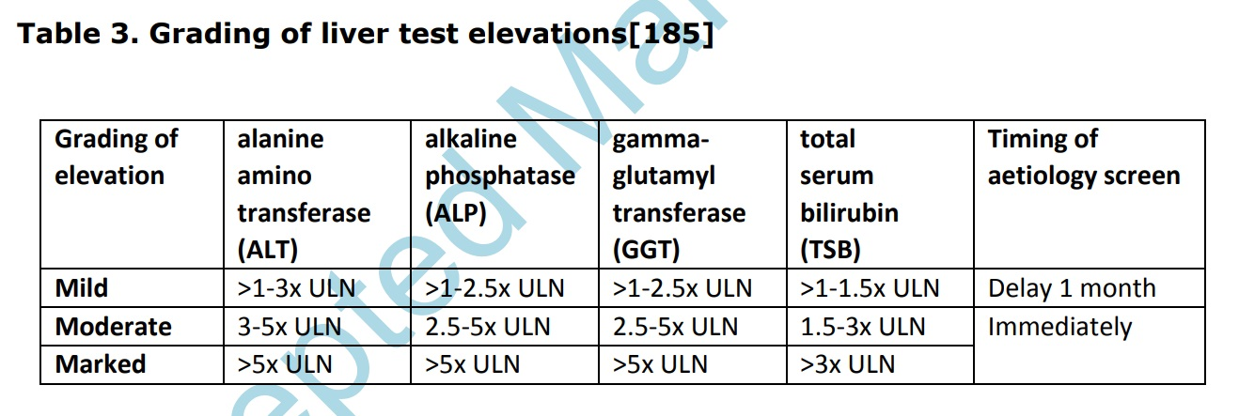

Slide 7
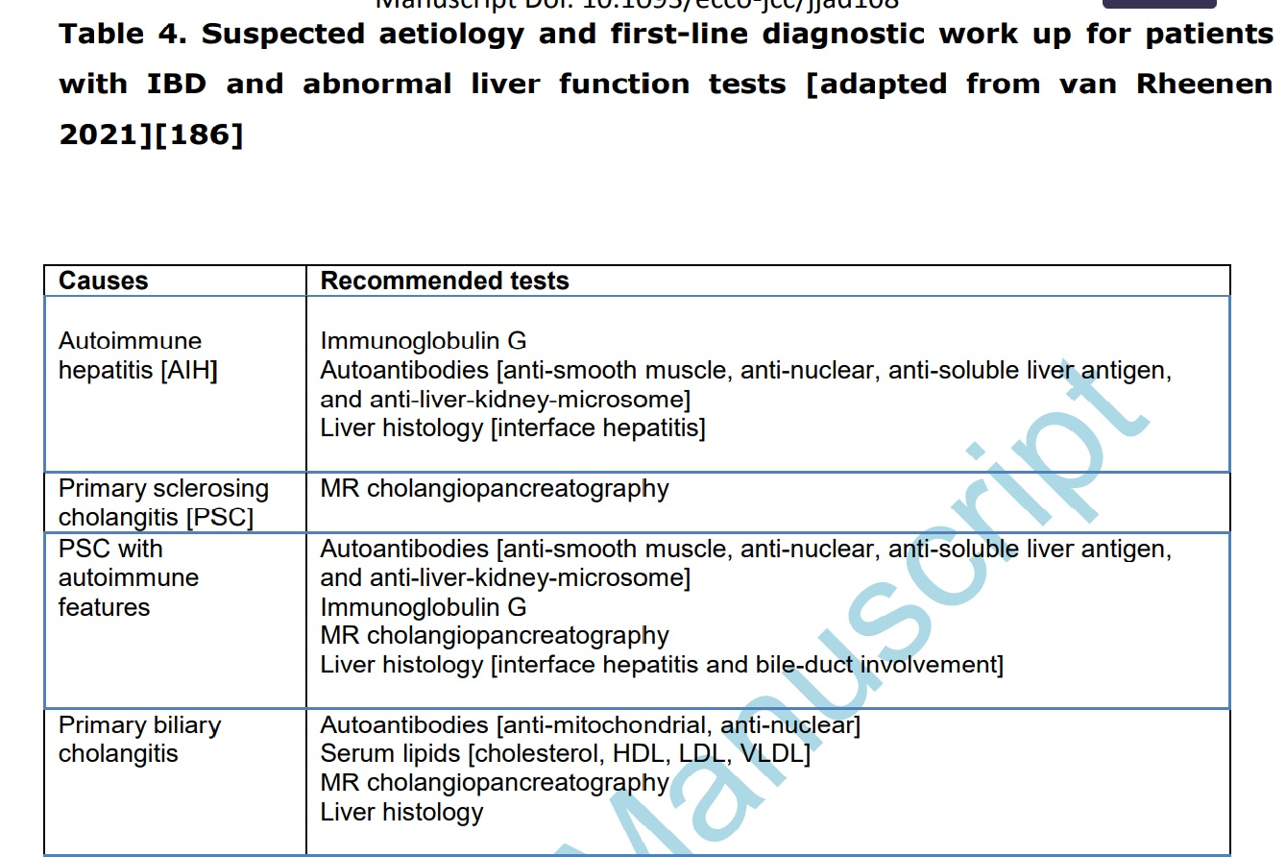

Slide 8
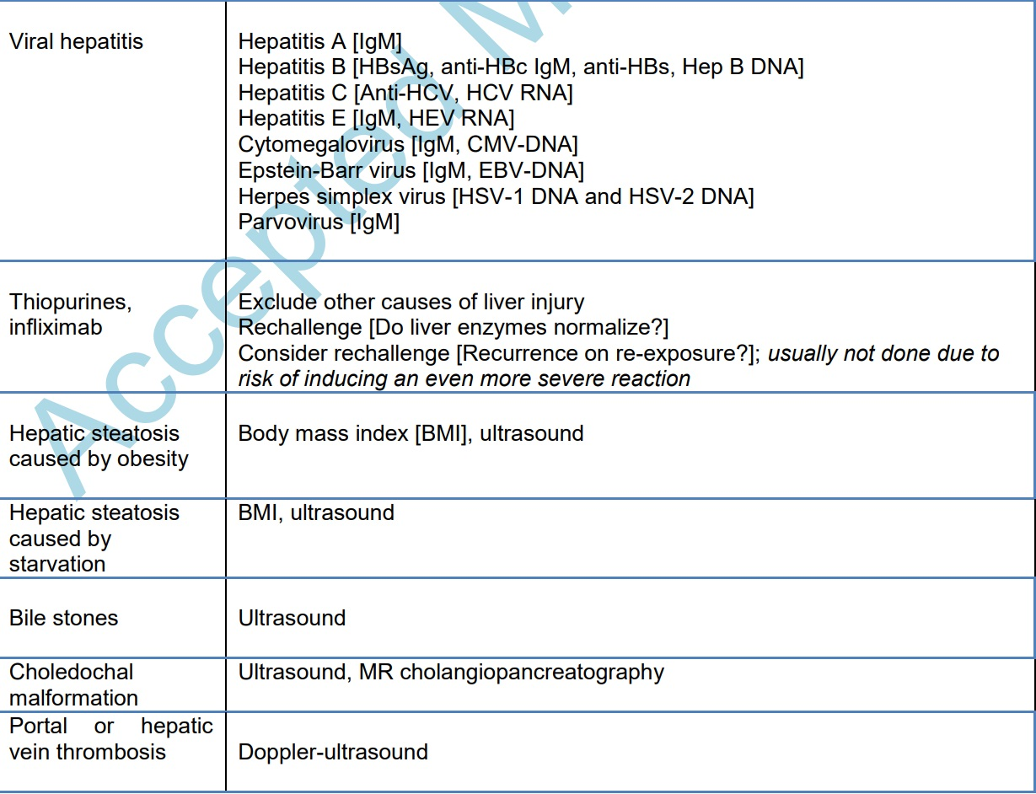

Slide 9
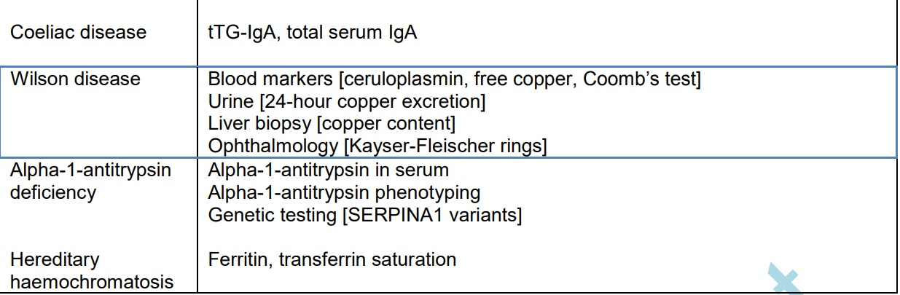

Slide 10
Primary sclerosing cholangitis
PSC is a chronic cholestatic liver disease characterized by inflammation and fibrosis of the bile ducts and confers a significant risk of end-stage liver disease, malignancy, and mortality.
The prevalence of PSC in IBD was estimated at 2.16% in a meta-analysis, with higher prevalence in UC compared with CD.
In the Swiss IBD cohort, PSC prevalence was 4% in UC and 0.6% in CD.

Slide 11
Radiological screening of IBD patients for PSC using magneticresonance cholangiopancreatography [MRCP] increased the frequency from 2.2% to 8.1%.
Risk factors for PSC are UC, male gender, pancolitis, nonsmoking, and prior appendicectomy .
Repeatedly elevated cholestatic liver enzymes should prompt diagnostic workup for PSC.
However, liver enzymes, including alkaline phosphatase levels, may be normal in PSC, and imaging signs such as periportal lymphadenopathy or enlarged gallbladder volume are also suggestive of PSC.

Slide 12
MRCP is the method of choice to diagnose PSC. High-quality MRI is essential to capture early bile-duct pathology.
Liver biopsy should be performed on patients in whom markedly elevated transaminases, serum IgG levels, or both raise suspicion of additional features of autoimmune hepatitis (AIH) and in those with suspected small-duct PSC, defined by a normal cholangiogram.

Slide 13
It is important to diagnose PSC even in asymptomatic patients with IBD, as the presence of PSC increases mortality up to 4-fold in population-based studies.
Mortality risk is higher in adult PSC patients <40 years as compared to older adults, although overall disease course is similar between children and adults.
PSC may progress to cirrhosis and end-stage liver disease within 12–20 years and thus represents an important indication for liver transplantation.
PSC greatly increases the risk of hepatobiliary and colorectal cancer, with a HR of 2.4 for developing colorectal cancer (CRC), and up to 400-fold increased risk of cholangiocarcinoma compared with the general population.

Slide 14
Medical management of PSC in adults with IBD
Although several drugs have been evaluated for the treatment of PSC, none have shown a benefit in slowing progression.
Ursodeoxycholic acid [UDCA] [15– 20 mg/kg/d] improves liver biochemistry but does not improve fatigue, pruritus, risk of cholangiocarcinoma, or mortality.
In some studies, a medium-low dose [<25mg/kg/d] was associated with a reduced risk of neoplasia.
In other studies, a higher dose was associated with a higher risk and more adverse events, while other studies showed no difference.

Slide 15
Vedolizumab has been evaluated in several retrospective studies. A clear benefit in PSC has not yet been demonstrated.
Adalimumab and infliximab have no influence on biochemical response in PSC.
Antibiotics and antifibrotics also have not demonstrated benefit.
Bezafibrate may be considered for management of pruritus.
In patients with the PSC/AIH variant, corticosteroids, immunosuppressants, or both can be considered.

Slide 16
Hepatologist involvement and referral to transplant centres in psc

Slide 17
A population-based study from the Netherlands showed that 50% of patients require liver transplantation 15–20 years after PSC diagnosis.
we strongly recommend that all patients with newly diagnosed PSC-IBD are referred to a hepatologist with expertise in PSC.
Thereafter, joint care should continue to ensure timely identification of patients who should be listed for liver transplantation.

Slide 18
The Model for End-Stage Liver Disease [MELD] score is used to prioritize patients for liver transplantation.`
Apart from the MELD score, which is a proxy for the severity of hepatic dysfunction, there may be additional indications for transplant assessment in patients with PSC.
These additional indications include recurrent bacterial cholangitis, severe weight loss, relevant bile-duct strictures, intractable pruritis, and perihilar cholangiocarcinoma

Slide 19
Autoimmune hepatitis and overlap syndrom
AIH and IBD have a bidirectional association.
In adolescents with IBD, the OR for AIH was 8 in patients with UC and 4 in patients with CD.
AIH/PSC overlap is common, with up to 10% of adult AIH patients exhibiting concurrent features of PSC.
AIH presentation varies from insidious and asymptomatic elevation of liver enzymes to fulminant liver failure.

Slide 20
Elevation of serum transaminases, selective elevation of serum IgG levels, non-organ specific autoantibodies, and a typical or compatible liver histology are hallmarks of AIH diagnosis.
The diagnostic scoring system typically used to diagnose AIH is based upon autoantibodies, IgG, exclusion of viral hepatitis, and histology.
However, this test has not been validated in the IBD population, where autoantibodies are frequently detected in IBD and in both AIH and PSC, rendering them less diagnostically useful.

Slide 21
When AIH is suspected, MRCP should be considered, especially in children and adolescents where there is a frequent occurrence of PSC/AIH overlap syndrome, also termed variant syndrome or autoimmune sclerosing cholangitis (ASC) .

Slide 22
For induction of remission, prednisolone/prednisone is recommended, although budesonide can be considered in patients without cirrhosis.
For the maintenance of remission, azathioprine is the standard treatment for AIH, usually started after 2 weeks, following biochemical response.
In patients who are already receiving alternative immunosuppressive therapy for IBD, a switch to or additional treatment with thiopurines should be considered.
Mycophenolate or mercaptopurine are second-line treatment option and infliximab may be effective, even in refractory disease.

Slide 23
Maintenance therapy for AIH should be continued for at least 2 years with the patient in remission before treatment withdrawal is attempted.
Patients with features of both AIH and PSC should be treated for AIH; UCDA can be considered for the cholestatic component of disease.
However, as in PSC alone, benefit beyond improving liver biochemistry is questionable, with no firm evidence to support improved prognosis.

Slide 24
Prognosis of AIH in general is favourable, but overall mortality remains increased.
In patients with the AIH/PSC variant, the sclerosing cholangitis component negatively impacts prognosis.
Compared to patients with PSC alone, additional features of AIH may be associated with improved transplantation-free survival in adults.

Slide 25
Pancreatitis
Compared to the general population, patients with IBD have an increased risk of developing acute pancreatitis, with a pooled annual incidence of 210 per 100 000 patient-years.
The prevalence of autoimmune pancreatitis [AP] is 3 times higher in IBD [OR: 3.11; 95% CI: 2.93–3.30] and significantly higher in CD than UC [OR 4.12 vs OR 2.61].

Slide 26
clinical presentation in IBD is similar to that of the general population.
Diagnosis can be made with the revised Atlanta classification, which requires at least two of the three following criteria to be present: upper abdominal pain, elevation of amylase or lipase three times the upper limit, and consistent radiology.
Recurrent abdominal pain is common in IBD, with asymptomatic increases in serum amylase, lipase, or both in 8–21% of IBD patients, which may lead to diagnostic uncertainty.

Slide 27
Acute pancreatitis in IBD has multiple causes and is commonly associated with gallstone disease [21%], alcohol intake [15%], medications [12%], and duodenal CD [13%].
Less common causes include hypertriglyceridaemia, hypercalcaemia, sequelae following endoscopic procedures [endoscopic retrograde cholangiopancreatography, double-balloon enteroscopy], AP, PSC, and vascular disease such as thrombosis, ischemia, or vasculitis.

Slide 28
Drug-induced pancreatitis is largely associated with thiopurines.
5-ASAs and ciclosporin have also been implicated, as indeed have metronidazole or corticosteroids, although drug-induced pancreatitis due to the latter is rare.
Between 4–7.5% of patients with IBD treated with azathioprine develop AP.
Development is dose-independent and typically occurs within the first 3 to 4 weeks of treatment.

Slide 29
Smoking and female gender are risk factors.
The pathophysiology of pancreatitis induced by 5-ASA is unknown; it is not dose-related, occurs regardless of the method of administration, and can present at any time during treatment.
In case of drug-induced pancreatitis, thiopurines and 5-ASAs should be immediately stopped and re-challenge should not be attempted.

Slide 30
Patients with CD have a 3-fold increased risk of developing gallstones, thus increasing the risk of gallstone pancreatitis.
The prevalence of AP in IBD is 0.4–1.2%, with the association of these diseases hypothesized to be due to shared antigenic molecules triggering an immune-mediated response in both organs

Slide 31
AP in patients with IBD is managed similarly to other patients, including supportive care with fluids, pain control, and nutritional support.
Asymptomatic increases in lipase and amylase levels do not require therapy; indeed, these tests should not be requested in absence of symptoms of pancreatitis.

Slide 32
Chronic pancreatitis in IBD is characterized by the presence of pancreatic duct abnormalities, functional abnormalities and, in most cases, absence of parenchymatous calcification.
The prevalence of pancreatic duct changes, such as main duct obstruction, severe duct irregularity or dilatation, or ductal filling defects, have been found in 8% and 16% of patients with CD and UC, respectively.
7–77% of patients with PSC have pancreatic duct changes.

